Slide 1

Week 8:
Natural Language Processing
Machine Learning Using Tensorflow
Shu-Ting Pi, PhD
UC Davis

Slide 2
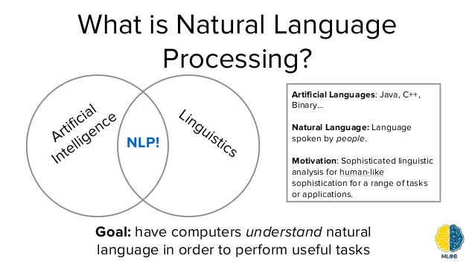
What is Natural Language Processing
Check : https://en.wikipedia.org/wiki/Natural_language_processing
Deep Learning Using Tensorflow and Keras
Shu-Ting Pi

Slide 3
How to perform simple NLP in deep learning?
Collect data
digitize data
Word embedding
CNN, RNN, RNN+LSTM, Deep RNN
Seq2Se2, Attention-Based,…,etc
You could publish a paper by using different combinations !
Deep Learning Using Tensorflow and Keras
Shu-Ting Pi

Slide 4
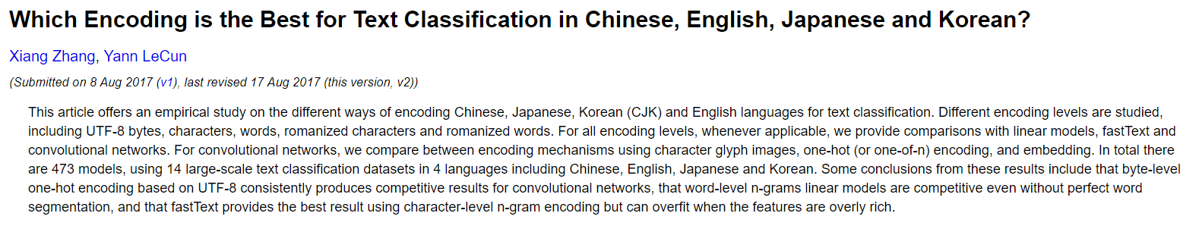
Models, Models, …, and Models !
4 languages, 473 encoding models on CNN !
Deep Learning Using Tensorflow and Keras
Shu-Ting Pi

Slide 5
Digitalize your data

Slide 6

IMDB database
http://ai.stanford.edu/~amaas/data/sentiment/ train: 2500, test: 25000
Deep Learning Using Tensorflow and Keras
Shu-Ting Pi

Slide 7
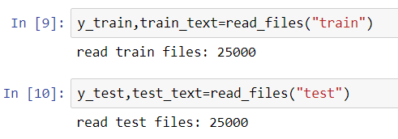
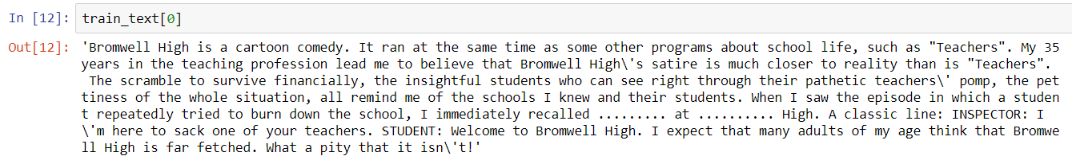
Take a look on the dataset
Positive comment: +1, Negative comment: -1
Deep Learning Using Tensorflow and Keras
Shu-Ting Pi

Slide 8
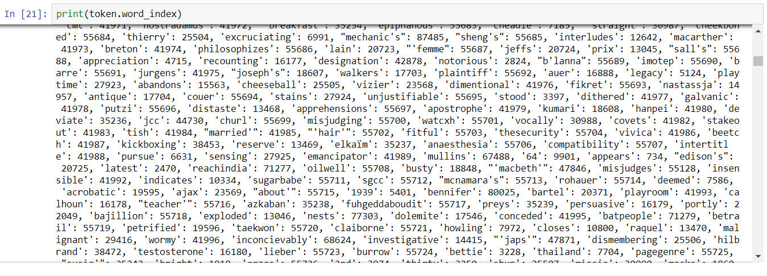
Build Dictionary
Build a dictionary with top 2000 high-frequency words
Deep Learning Using Tensorflow and Keras
Shu-Ting Pi

Slide 9
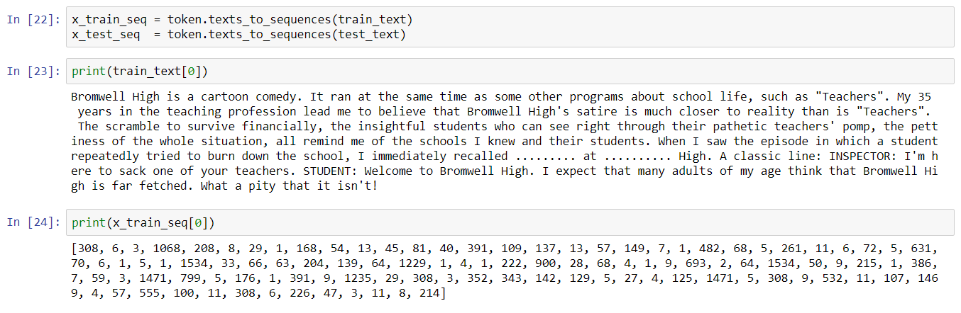
Convert word to index
Use dictionary indexes to replace words. If a word not in the list, ignore it.
Deep Learning Using Tensorflow and Keras
Shu-Ting Pi

Slide 10
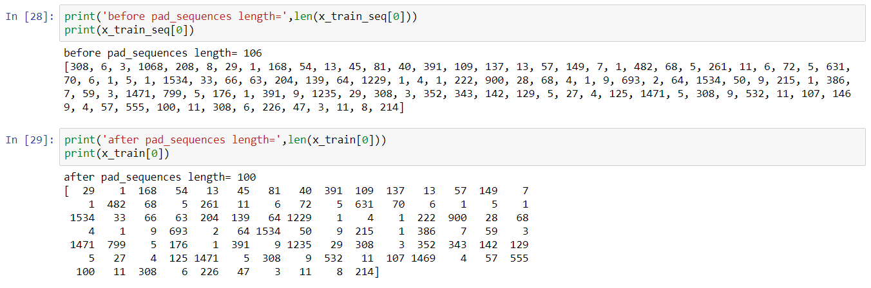
Word padding
Ok, now all data become vectors with the same size !
Too long => truncate the front part
Too short => put 0 in the front part
Deep Learning Using Tensorflow and Keras
Shu-Ting Pi

Slide 11
Word Embedding

Slide 12
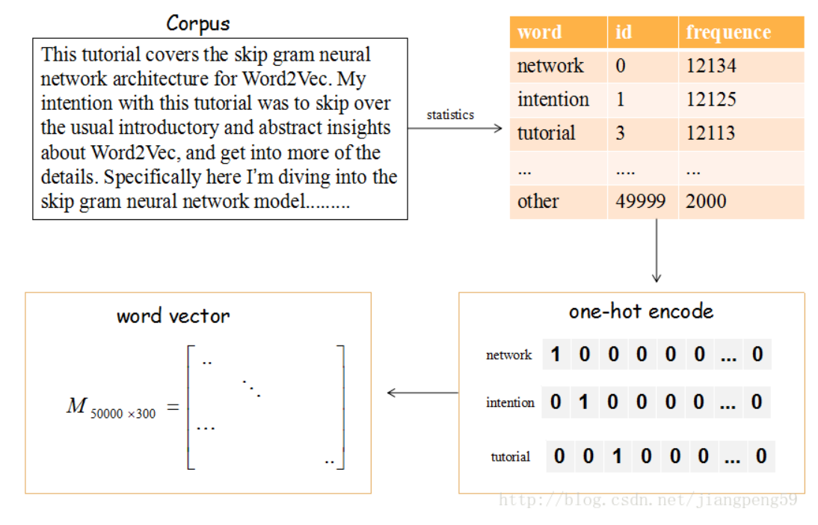
What is word embeding?
One-hot encoding is bad:
1). sparse 2). high dimension
3). words are not relevant 4).word vectors are “orthogonal”
Deep Learning Using Tensorflow and Keras
Shu-Ting Pi

Slide 13
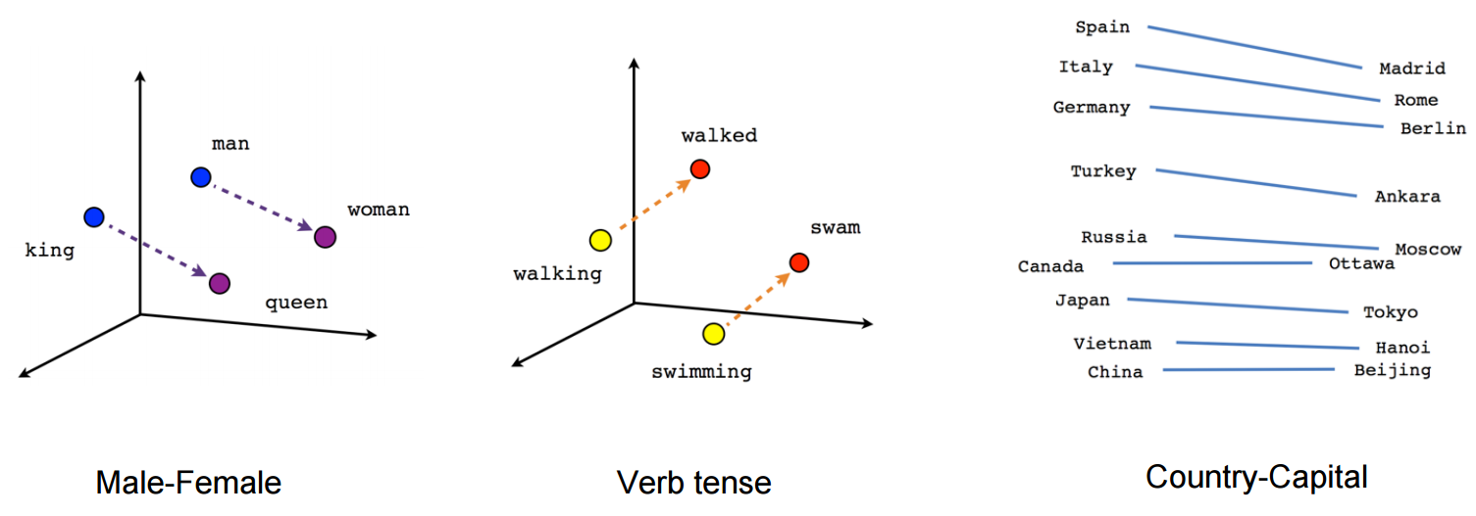
What can word embedding tell us?
(King) – (man) = (queen)
(queen) – (woman) = (king)
(walked) – (walking) =
(swam)-(swimming)
(Rome) + (Madrid) =
(Italy)+(Rome)
At least: school, teacher, students are close
Deep Learning Using Tensorflow and Keras
Shu-Ting Pi

Slide 14
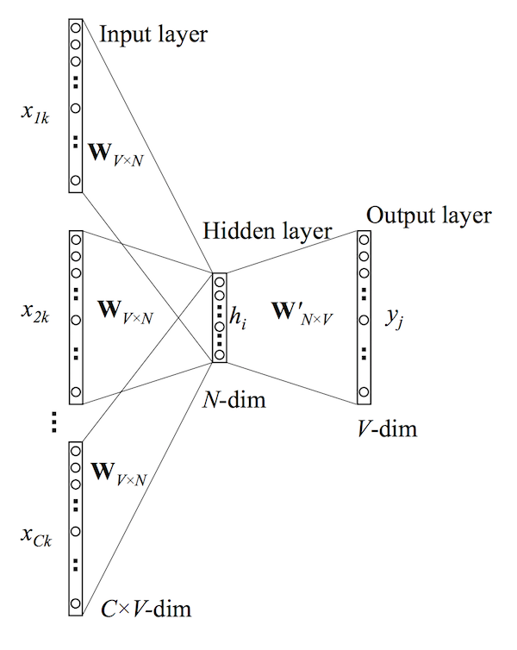
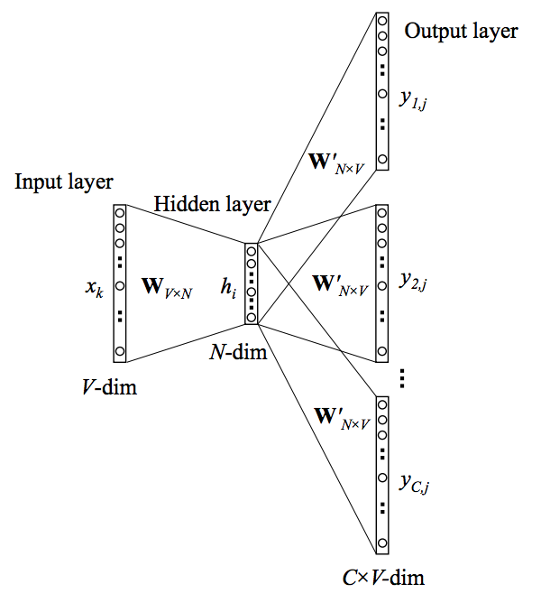
Word2Vec
CBOW
Skip-gram
CBOW is faster but Skip-gram is better for infrequent words
Glove is another popular word embedding algorithm based on co-occurrence (much faster!
Deep Learning Using Tensorflow and Keras
Shu-Ting Pi

Slide 15
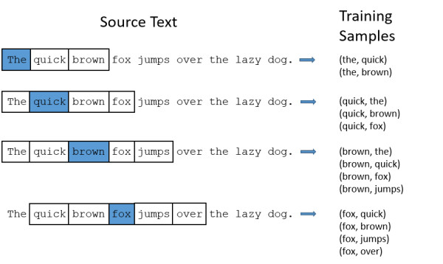
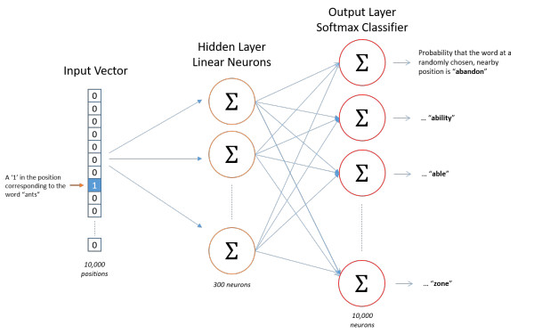
Skip-gram
Deep Learning Using Tensorflow and Keras
Shu-Ting Pi

Slide 16
Popular Models

Slide 17
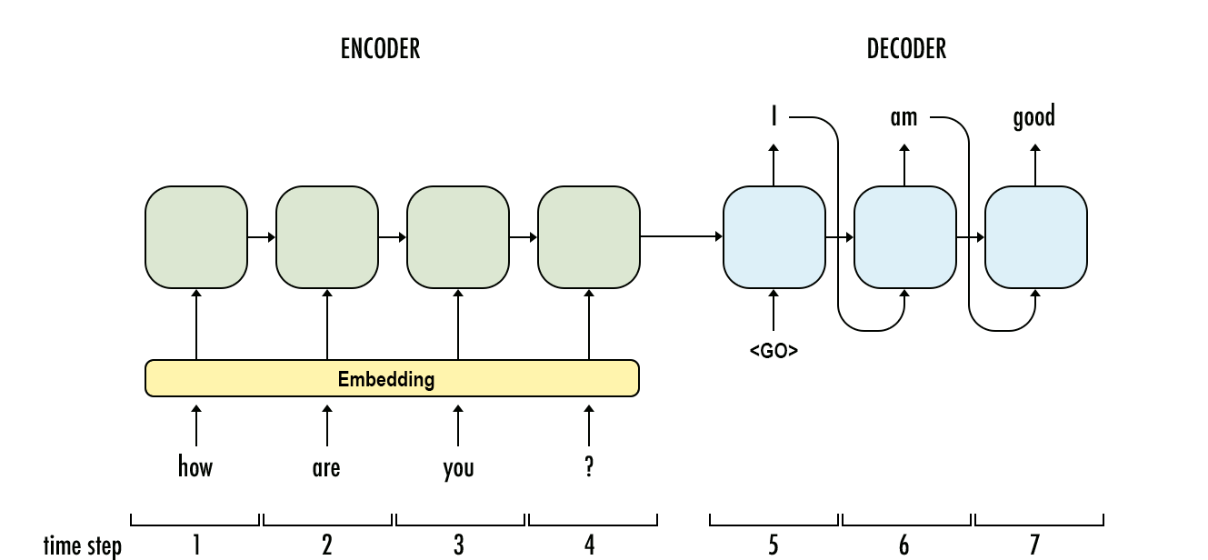



sequence-to-sequence model
Deep Learning Using Tensorflow and Keras
Shu-Ting Pi

Slide 18
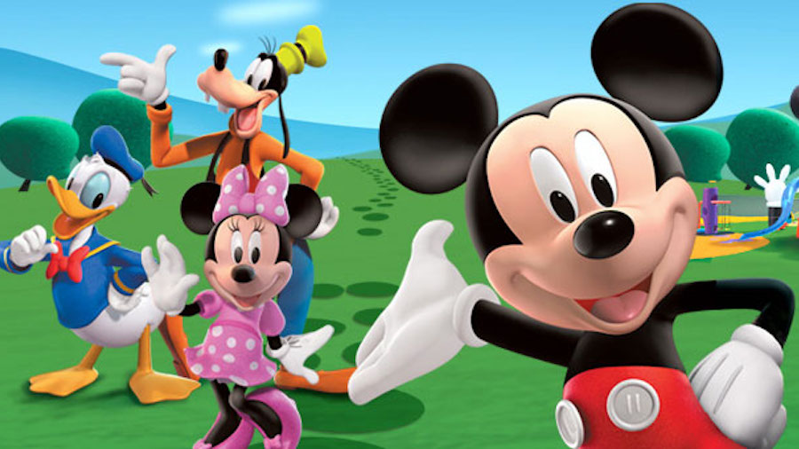
Attention-Based Model
Focus on Mickey
Can you tell me some details of Goofy
https://arxiv.org/abs/1508.04025
Deep Learning Using Tensorflow and Keras
Shu-Ting Pi

Slide 19
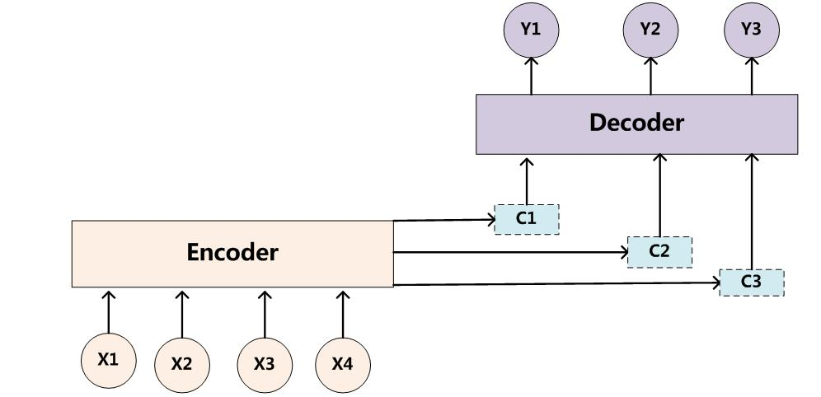
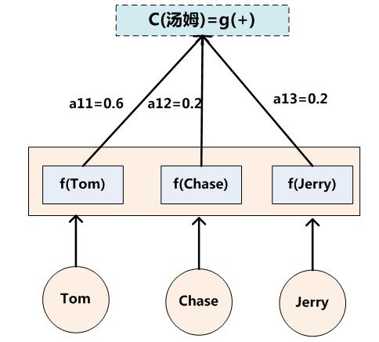
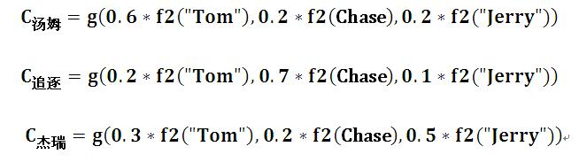
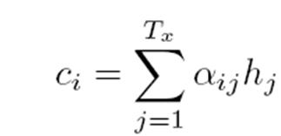
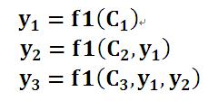
Attention-based model
g
Deep Learning Using Tensorflow and Keras
Shu-Ting Pi

Slide 20
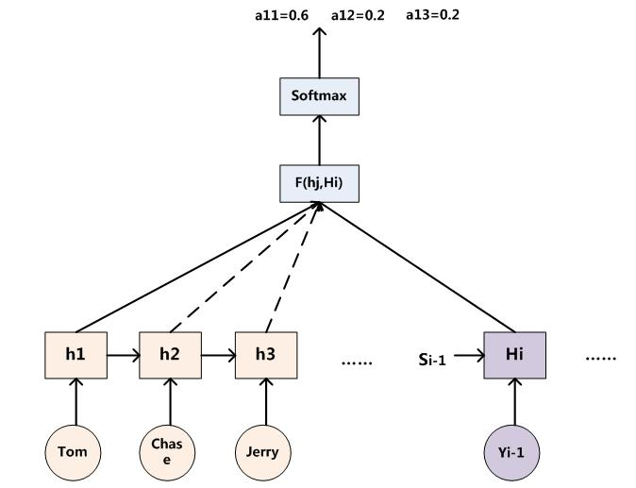
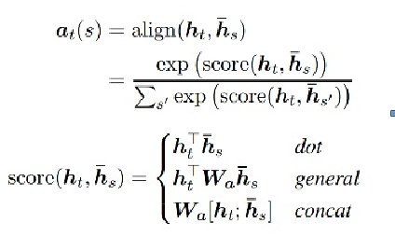
How to get attention weight?
Wa are parameter matrix to be learned
Deep Learning Using Tensorflow and Keras
Shu-Ting Pi

